Slide 1
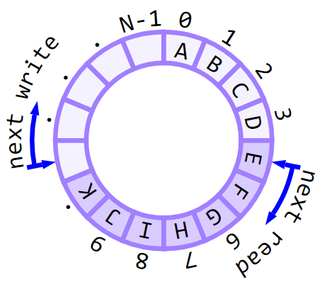
Ring Buffers
(Why software is hard)
Chris Lomont, 2019
chris@lomont.org
clomont@Logikos.com
Notes:
Also called FIFO queue, circular queue, bounded queue, others in literature

Slide 2
Intro
This talk will cover a simple data structure, taken from the basic concept to production quality
It will illustrate a lot of tricks, nuances, and design tradeoffs
It illustrates that software is hard – the simple idea of a ring buffer is far removed from a production quality one

Slide 3
Design purpose
I needed a ring buffer for an embedded project
Design needs
An interrupt fills a ring buffer asynchronously from the main program
Main program consumes data when available
One or more physical CPUs (needed for Atmel SAMD21, Expressif ESP32)
Very RAM conscious: the SAMD21 has 4K of RAM to implement a USB host
High performance
Standalone, reusable, modern C++ design principles
I found nothing available, created high performance Ring Buffer
Design and implementation illustrative of high and low level tricks

Slide 4
Outline
Start with a simple design and implementation
Test to catch bugs
Make changes a little at a time to improve
10 different ring buffers, each better than the previous

Slide 5
Simple Ring Buffer
State:
Simple array size N to store data
Next place to read is readIndex
Next place to write is writeIndex
API roughly (actually, this is not the first I tried, but they evolved to this)
bool IsEmpty
bool IsFull
int AvailableToRead
int AvailableToWrite
int Size
bool Put(datum)
bool Get(&datum)

Slide 6
Simple Ring Buffer
size_t size_;
uint32_t readIndex_{ 0 };
uint32_t writeIndex_{ 0 };
vector<char> buffer_;
size_t AvailableToRead() const
{
return (writeIndex_ - readIndex_ + size_) % size_;
}
size_t AvailableToWrite() const
{
return size_ - AvailableToRead();
}
bool IsEmpty() const { return AvailableToRead() == 0; }
bool IsFull() const { return AvailableToRead() == size_; }
size_t Size() const { return size_; }
bool Put(char datum)
{
if (IsFull()) return false;
buffer_[writeIndex_] = datum;
writeIndex_ = (writeIndex_ + 1) % size_;
return true;
}
bool Get(char & datum)
{
if (IsEmpty()) return false;
datum = buffer_[readIndex_];
readIndex_ = (readIndex_ + 1) % size_;
return true;
}

Slide 7
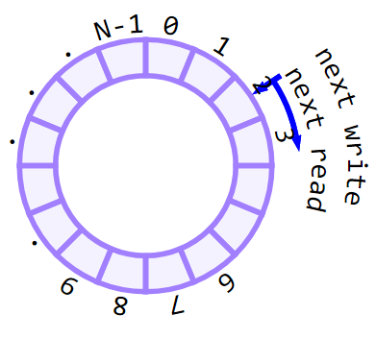
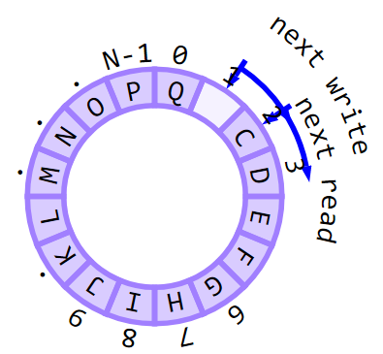
Simple Ring Buffer
Previous has multiple bugs: can you find them?
Can it really hold N items?
Nope, it holds N-1. What to fix?
Fix Size, AvailableToWrite, IsFull
Second much harder:
Empty W=R
size_t size_;
uint32_t readIndex_{ 0 };
uint32_t writeIndex_{ 0 };
size_t AvailableToRead() const
{
return (writeIndex_ - readIndex_ + size_) % size_;
}
Full W=R-1

Slide 8
Simple Ring Buffer
size_t size_;
uint32_t readIndex_, writeIndex_;
(writeIndex_ - readIndex_ + size_) % size_;
Hint: this fixes: (size_ + writeIndex_ - readIndex_) % size_;
Also this: (static_cast<size_t>(writeIndex_) - readIndex_ + size_) % size_;
size_t is basically uint64_t
Order and promotion rules subtle.

Slide 9
Simple Ring Buffer
C/C++ does not define over/underflow of signed integers
So I designed using unsigned types
In this case: I encountered a wraparound of a size 513 buffer:
write = 31, read = 512, math should then be write – read + 513 = 32,
mod 513 should be 32.
Instead:
write - read is -481 = 0xFFFF’FE1F as 32 bit hex,
Add 32 bit unsigned to 64 bit unsigned size 513: 0xFFFF’FE1F expanded to 0x0000’0000’FFFF’FE1F, not 0xFFFF’FFFF’FFFF’FE1F
Add to 513 = 0x0000’0000’0000’0201 as 64 bit hex,
Obtain 0x0000’0001’0000’0020 as 64 bit hex. Note 1 way out there
Now taking mod 513 returns 0, not 32!

Slide 10
Generic Ring Buffer
Templatize items for flexibility
Data type – can hold packets, etc.
Size, allows compiler optimizations, can remove storing size as variable
Downside – now multiple types GRB<32> versus GRB<64>, can subclass if needed
Index type – allows smaller memory – don’t always need 32 bit index
template <size_t N = 512, typename DataType = char, typename IndexType = uint32_t>
class GenericRingBuffer

Slide 11
Locked Ring Buffer
Need to make threadsafe
Use locks, C++11 to C++17 ok.
API now dangerous and flakey
For example, int AvailableToRead not safe under multiple readers
Could relabel, or could remove or rethink
Safer to simply kill bad named functions

Slide 12
Locked Ring Buffer
using Scoped = lock_guard<recursive_mutex>;
…
bool Put(const DataType & datum)
{
Scoped guard(lock_);
if (IsFull())
return false;
buffer_[writeIndex_] = datum;
writeIndex_ = (writeIndex_ + 1) % N;
return true;
}
…
mutable recursive_mutex lock_;
Locking guidelines
simply using mutex hangs, use recursive_mutex.
Use scope guards for exceptions
Need mutable lock for const members,
ugly, must be careful to meet const for classes how C++ expects them

Slide 13
Benchmarking
First benchmarks:
One thread, ring buffer size N, write M, read M in loop
Two threads, same as above, in 2 threads
Cannot compare throughput between 1 and 2 easily!
Want about 30-50 ms per sample on Windows (15 ms thread slices)
Lower, hit numeric issues
Higher, don’t get more info, just slower to test
Want enough OS thread slices overall to gather good avg data
Intel Core i7, Visual Studio 2017 C++, x64, Release mode.
TODO - Atmel SAMD21, GCC Atmel7 studio

Slide 14
Performance I
Note sizes near power of 2 speeds

Slide 15
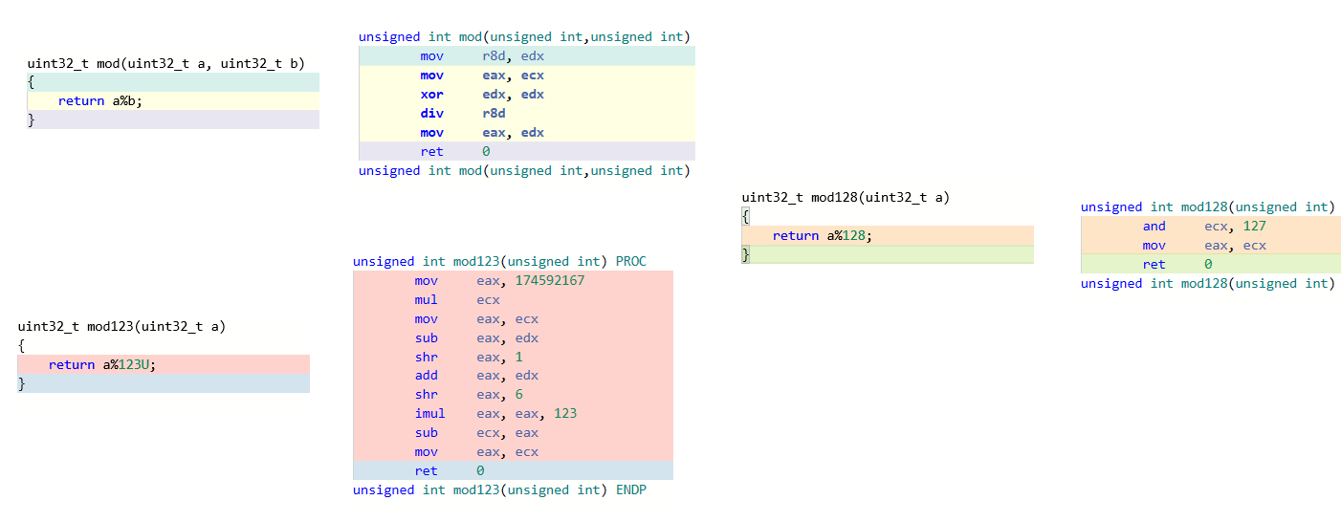
Performance I
Hint: 10 * (2^31) / 123 = 174592166.504

Slide 16
Atomics Ring Buffer
We have one writer (interrupt), one reader (main loop)
This called a Single Producer, Single Consumer (SPSC) Ring Buffer
Also have SPMC, MPMC, MPSC, etc.
Can redo API nicely:
// how many items available to write in [0,Size]
// if called from consumer, true size may be less since producer can be adding
// if called from producer, true size may be more since consumer may be removing
// undefined to call from any other thread
size_t AvailableToWrite() const { return Size() - AvailableToRead(); }
atomic<IndexType> readIndex_{ 0 };
atomic<IndexType> writeIndex_{ 0 };
array<DataType, N> buffer_;

Slide 17
Atomics Ring Buffer
We can replace locking with std::atomics
Read each at most once per function, same order safest
Best to read papers instead of making your own:
Lamport paper 1977
// try to put the item in, return false if full
bool Put(const DataType & datum)
{
IndexType w = writeIndex_;
IndexType r = readIndex_;
if ((w+1)%N == r)
return false;
buffer_[w] = datum;
writeIndex_ = (w + 1) % N;
return true;
}
Notes:
Correct and Efficient Bounded FIFO Queues, https://www.irif.fr/~guatto/papers/sbac13.pdf

Slide 18
Performance 2
Atomic vastly faster than locked, single or double threads

Slide 19
Modulus Ring Buffer
Modulus % is computationally expensive.
Our values should stay in 0 to N-1
% for N power of 2 is very cheap: simply AND mask with N-1
Replace % with ‘if’
Trades expensive % with possibly expensive branch
Want template magic to select which at compile time
template <..., typename RingMod> class ModulusRingBuffer { ...
size_t AvailableToRead() {
return RingMod::Mod1N(N + writeIndex_ - readIndex_); }
...
// template to detect if N is power of 2
template<size_t N> struct is_power_of_two {
static const bool value = N && ((N & (N - 1)) == 0);};
// pick based on power of 2 or not
template<size_t N, typename IndexType>
using FastRingMod = conditional_t<is_power_of_two<N>::value,
FastRingModPowerOfTwo<N, IndexType>,
MidRingMod<N, IndexType>
>;

Slide 20
Modulus Ring Buffer
template<size_t N, typename IndexType>
struct MidRingMod {
// given integer in [0,2N-1], return mod N in [0,N-1]
static inline IndexType Mod1N(const IndexType & index)
{
if (index < N) return index;
return index - N;
}};
...
SlowRingMod => return index % N;
FastRingModPowerOfTwo => return index & (N - 1);

Slide 21
Relaxed Ring Buffer
CPU, compiler, and language memory models allow reordering loads and stores across threads and caches.
C++ atomic forces strict sequential ordering
sequential consistency => 1) Each thread ordered, 2) overall order is total ordered
Relax => Replace default atomic read/write with weakest correct requirement
VERY hard to get correct!
C++ atomics memory_order_... | Meaning
acquire | All following loads not moved before any current or preceding loads
release | All preceding stores not moved past any current or later stores
acq_rel | Does both acquire and release
consume | Weaker form of acquire, only does acquire on data dependent loads
relaxed | All reorderings ok
seq_cst | Default: sequential consistency
Notes:
Remark: best to find a paper, then scan papers citing it to see if improvements/corrections
Difference between seq_cst and acq_rel is latter is only relative to the sinlge atomic variable, seq_cst is global.
i.e. Seq_cst is across all threads

Slide 22
Relaxed Ring Buffer
// try to put the item in, return false if full
bool Put(const DataType & datum)
{
IndexType w = writeIndex_.load(memory_order_relaxed);
const IndexType nextWrite = RingMod::Mod1N(w + 1);
if (nextWrite != readIndex_.load(memory_order_acquire))
{
buffer_[w] = datum;
writeIndex_.store(nextWrite, memory_order_release);
return true;
}
return false; // buffer full
}
Note: branching order changed to often better choice - most taken closest

Slide 23
Performance 3

Slide 24
Full Size Buffer
Want to use all N slots in low memory device
read=write cannot both mark empty and full
Thus need another field to track which is which
A separate field is tricky to get right with atomics
Nice trick: instead of using numbers mod N, take them mod 2N
Gives another ‘bit’ of information to split full/empty cases
Downside: need an extra mod N during buffer read/write

Slide 25
Full Size Buffer
// try to write an element, fails if no space available
bool Put(const DataType & datum)
{ // paper above has ability to write bigger blocks, is faster
const auto w = writeIndex_.load(memory_order_relaxed);
const auto nextWrite = RingMod::Mod2N(w + 1);
if (nextWrite != readIndex_.load(memory_order_acquire))
{
buffer_[RingMod::Mod1N(w)] = datum;
writeIndex_.store(nextWrite, memory_order_release);
return true;
}
return false; // buffer full
}

Slide 26
Cache Ring Buffer
False sharing
Things close in memory but used by different threads
Either thread reads cache line, must read both items
Thrashes
Move lines around to put space between things for different threads
Can do better, greater cost…
atomic<IndexType> writeIndex_{ 0 };
array<DataType, N> buffer_;
atomic<IndexType> readIndex_{ 0 };

Slide 27
Blocks Ring Buffer
Most times one wants to write a block of bytes in
Often want to read a block out
Can avoid so many atomic hits by doing things in blocks
Add new APIs
bool Put(DataType * data, size_t n)
bool Get(DataType * data, size_t n)

Slide 28
Blocks Ring Buffer
// try to write n elements, fails if no space available
bool Put(const DataType * data, size_t n)
{
auto w = writeIndex_.load(memory_order_relaxed);
auto r = readIndex_.load(memory_order_acquire);
if (Size() - RingMod::Mod2N(2 * N + w - r) < n)
return false; // does not fit
auto t = RingMod::Mod1N(w);
for (auto i = 0; i < n; ++i)
buffer_[RingMod::Mod1N(t+i)] = data[i];
w = RingMod::Mod2N(w + n);
writeIndex_.store(w, memory_order_release);
return true;
}
Notes:
TODO – can possibly change to not use 2 mod per loop – mod in array w+i, then out of loop mod2n final w+n – errors – why? Possibly can split into values that stay in bounds, and do those – remove all per loop mod

Slide 29
Predictive Ring Buffer (final buffer)
Can avoid some atomic checks by caching a non-atomic value on each of producer/consumer side
Adds memory cost of two more counters
Improves performance on some architectures
// predictive read index, cache neighbors
IndexType pReadIndex_{ 0 };
atomic<IndexType> writeIndex_{ 0 };
DataType buffer_[N];
// predictive write index, cache neighbors
IndexType pWriteIndex_{ 0 };
atomic<IndexType> readIndex_{ 0 };
Notes:
Paper WeakRB
Paper shows only 1.25% of possible throughout on ARM, 0.6% on PC
WeakRB
Software caches to prevent multiple needs to check atomic

Slide 30
Predictive Ring Buffer (final buffer)
bool Put(const DataType * data, size_t n)
{
auto w = writeIndex_.load(...);
// predicted available to write
if ( Size() - RingMod::Mod2N(2 * N + w - pReadIndex_) < n)
{ // may not fit, check more exactly, costing an atomic read
pReadIndex_ = readIndex_.load(...);
// current available to write
if (Size() - RingMod::Mod2N(2 * N + w - pReadIndex_) < n)
return false; // does not fit
}
...

Slide 31
Performance 4
Relaxed, full buffer, large blocks, cache lines, predictive

Slide 32
Performance 5
Blocks vs predictive
note: carefully rewriting inner loop lifted values from 1100 to 1500

Slide 33
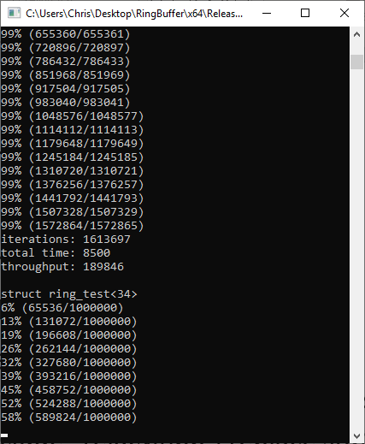
Correctness?
Extremely hard to prove correctness
Can stress test like crazy
Relacy Race Detector - header library to stress
Automatically does reorderings and tries to crash programs
Simply include “relacy.hpp”, replace std:: with rl::, and access vars of interest with suffix ($)
Can do with macros cleanly
Ran significant tests on final ring.

Slide 34
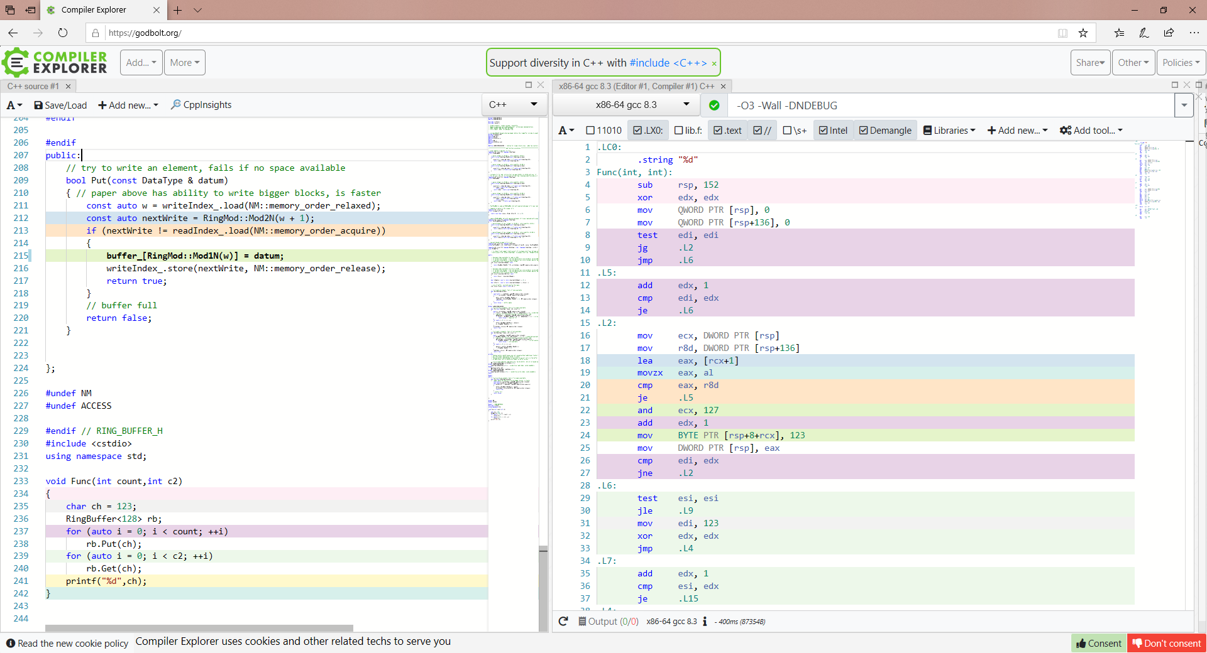
Looking at generated assembly – very compact

Slide 35
Performance 6

Slide 36
Performance 7

Slide 37
Conclusion
List of all improvement ideas and gain over previous:
Initial implementation
Made parameters generic to gain compiler optimizations
Made threaded with locks
Replaced locks with careful atomics
Replaced modulus with if and bitmask and template tricks
Replaced seq_cst atomics with careful load/store semantics
Replaced N-1 buffer with full N buffer via mod 2N math
Tried to arrange data for better cache and non-false sharing
Changed API to handle blocks instead of single put/get
Removed some cache sharing via predictive size buffering

